Slide 1
Dialing up the dialogue: Queensland’s Human Rights Act, 3 years on
Scott McDougall
Queensland Human Rights Commissioner

Slide 2
Acknowledgement of Country
The Queensland Human Rights Commission acknowledges Aboriginal and Torres Strait Islander peoples as the First Australians and recognises their culture, history, diversity, and their deep connection to the land, waters and seas of Queensland and the Torres Strait.
We pay our respects to the traditional owners of the land we meet on today and to elders, past, present and emerging.

Slide 3
Human rights in the news

Slide 4
Obligations under the Human Rights Act
Parliament when making new laws must demonstrate how human rights have been considered
Executive must give proper consideration to human rights when making decisions and act compatibly with human rights
Courts:
must consider any rights that apply by direct application
must interpret laws compatibly with human rights, and
are also bound as a ‘public entity’, when acting in an administrative capacity.

Slide 5
Override declaration
‘
‘
s43(4):
It is the intention of Parliament that an override declaration will only be made in exceptional circumstances.
Examples of exceptional circumstances -
war, a state of emergency, an exceptional crisis situation constituting a threat to public safety, health or order.
‘
‘

Slide 6
Not much of a right
‘
‘
Proponents of a Human Rights Act argue that infringement of the rights should result in an award of damage or compensation against the infringer. The logic of the argument must be accepted. A right, which does not punish or deter a transgressor who deprives another of the right, is not much of a right; and a person whose right was infringed, who does not receive recompense, may well feel the right exists in name only.
- Human Rights Inquiry Submission No. 475, April 2016
‘
‘

Slide 7
Piggy-back proceedings (s58)
Owen-D'Arcy v Chief Executive, Queensland Corrective Services [2021] QSC 273

Slide 8
The interpretation command
s.48:
all statutory provisions must, to the extent that is consistent with their purpose, be interpreted in a way that is compatible with human rights.
The application of the standard principles of statutory interpretation are to be applied. The consideration of human rights is now incorporated as part of context and also purpose where consistent with the purpose of the provisions
Williams J
SQH v Scott [2022] QSC 16 at [116]
SF v Department of Education [2021] QCAT 10

Slide 9
Direct application (s5)
Attorney-General for the State of Queensland v Grant [2022] QSC 180
and
Attorney-General for the State of Queensland v Grant (No 2) [2022] QSC 252

Slide 10
Court acting in an administrative capacity (s9)
Re Ipswich City Council [2020] QIRC 194

Slide 11
A gentle reminder
Notice provision (s52)
Commission’s intervention guidelines

Slide 12
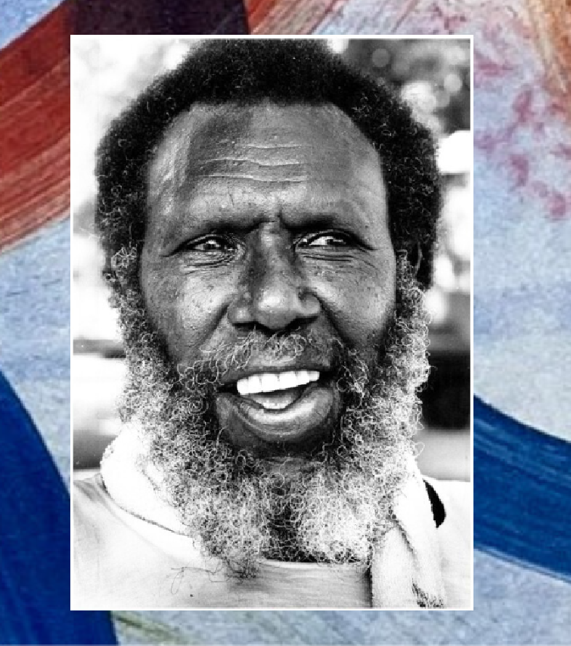
2023 Mabo Oration
Friday 2 June 2023
6pm, Quayside Terminal
South Townsville
Professor Megan Davis
with special guest speakers
Gail Mabo &
Professor Henry Reynolds
Details and tickets:
www.qhrc.qld.gov.au

